Slide 1
Collaboration Romande Energie - SDSC
Starting a data science project

Slide 2
st electricity provider in the French speaking part of Switzerland
1
4
Guaranteeing a stable, economically viable and green energy portfolio
Activities in the energy sector
Production
Distribution
Retail
Energy services
300'000 clients
In canton Vaud, Valais, Fribourg and Geneva.
Etat au 31 décembre 2018
Notes:
Notre vision
Faciliter et accélérer la révolution énergétique en Suisse.
Notre mission
Nos solutions innovantes et durables permettent à nos clients (particuliers, collectivités, entreprises), investisseurs et collaborateurs de tirer profit de la révolution énergétique et de développer ensemble un meilleur cadre de vie.

Slide 3
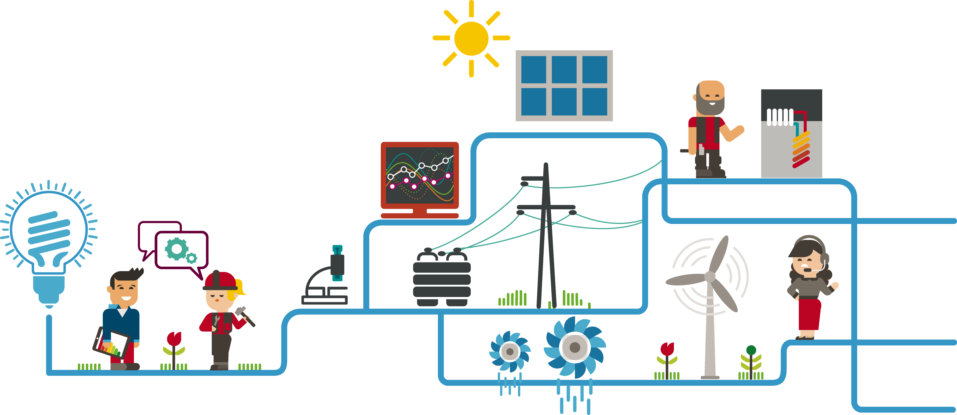
Innovation: the LAB
Romande Energie has a competence center for Innovation in the EPFL Innovation Park. The Lab has a focus on promoting innovation into the organisation and developing new business models based on the trends in the energy sector.

Slide 4
Energy is changing !
Notes:
Decarbonation
Decentralisation
Digitalisation

Slide 5
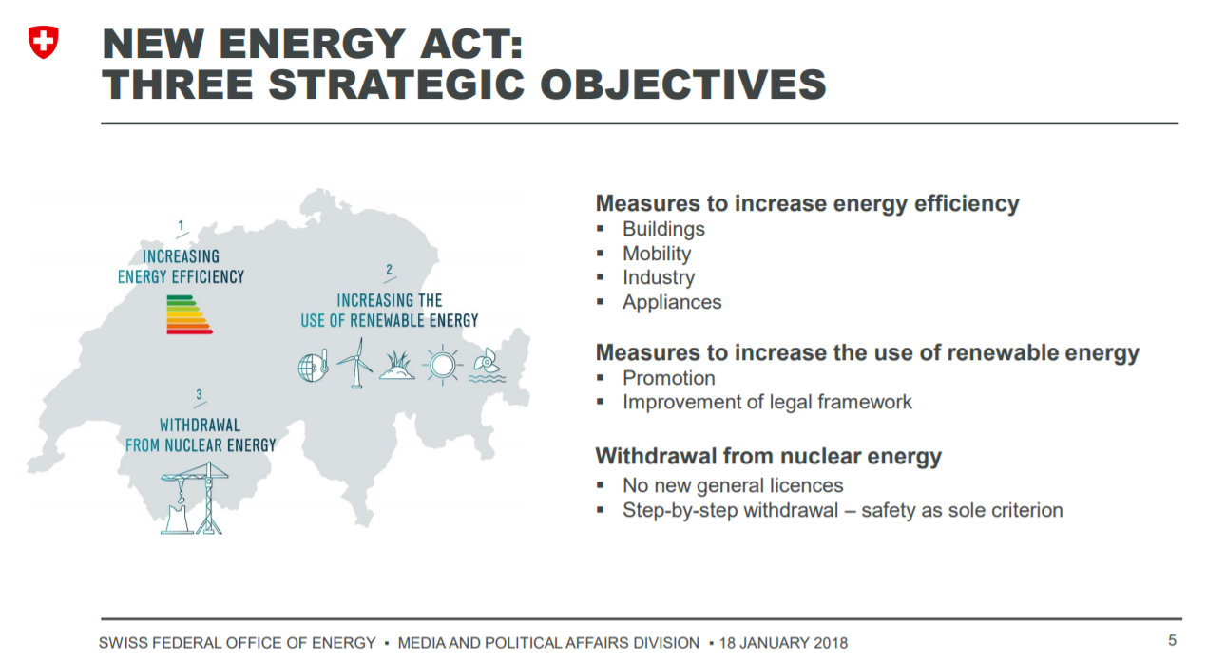
The swiss context
https://www.bfe.admin.ch/bfe/en/home/policy/energy-strategy-2050.html

Slide 6
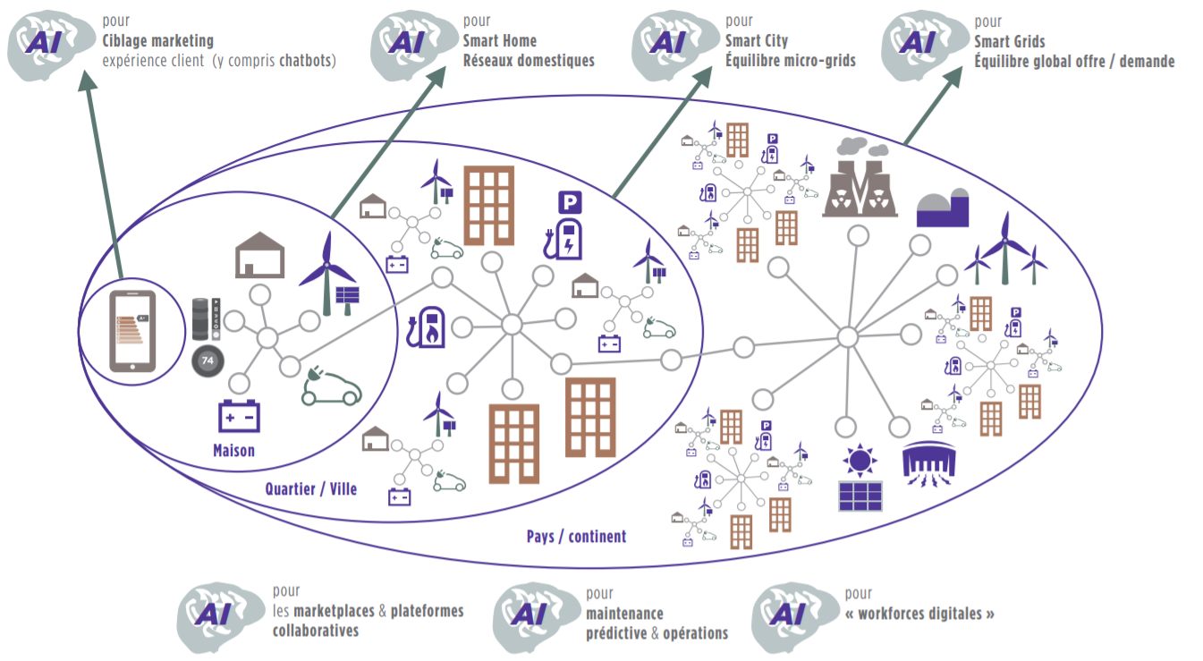
https://wavestone-advisors.co.uk/app/uploads/2017/05/Wavestone_Energie_et_Intelligence_Artificielle.pdf
Notes:
Where is data in energy?
Everywhere ! From household to GRID
What do we do at romande energie ?
We like smart grid topics
We want to build new products and services around geospatial data + Forcasting tehcniques on energy timeseries data

Slide 7
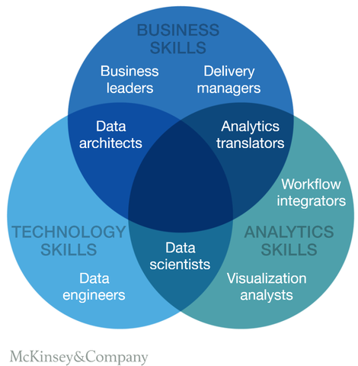


Analytics means collaboration
IT Department
Business units
Analytics
Notes:
Data Science is a sport team

Slide 8
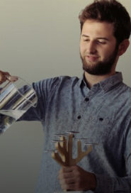
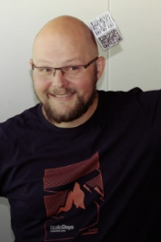
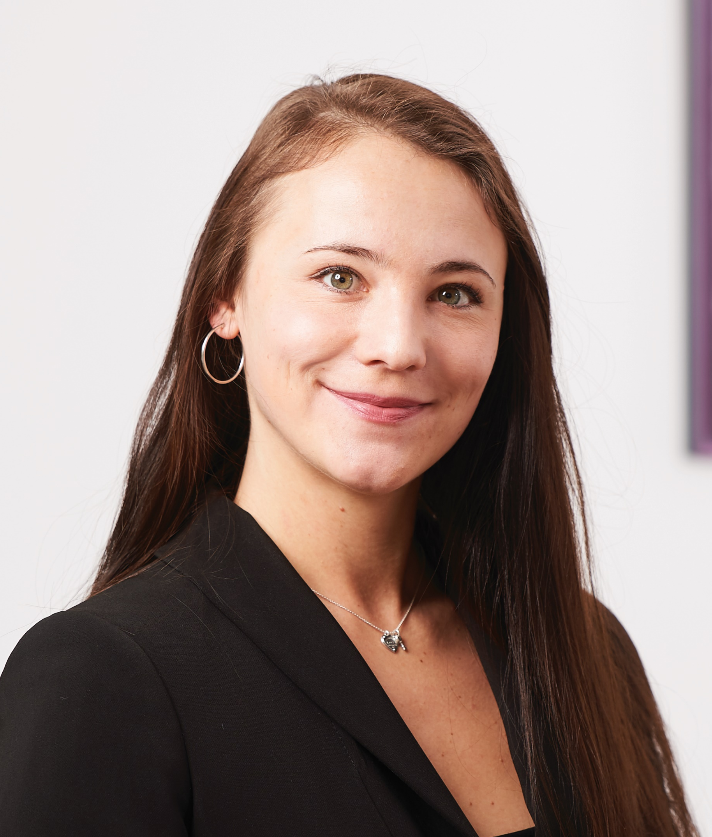
Merci de votre attention
Patrizio Canzi
Business Analyst
Nous nous tenons à votre disposition pour tout complément d’information.
Christophe Pache
Infrastructure & Data Engineer
Anna Androsova
Data Scientist
Swiss data science center

